Slide 1






Introduction to Marketing
Dr. Kalpana Ambepitiya
Ph.D. (Entrepreneurship), ACMI, MBA (Finance), MPA, PgDip (Management), BBMgmt (Marketing) Sp.Hons.
Department of Management and Finance,
General Sir John Kotelawala Defence University

Slide 2
Lesson Learning Outcomes
To be known about marketing at an important area of modern business
To learn the basic concepts of Marketing
To apply Segmentation, Targeting and Positioning (STP) in real context.

Slide 3
Scope of Marketing
Marketing is not only selling.
Marketing makes product/service fits customer’ requirement & sells itself ==> customer ready to buy
In the end, Marketing makes selling.

Slide 4
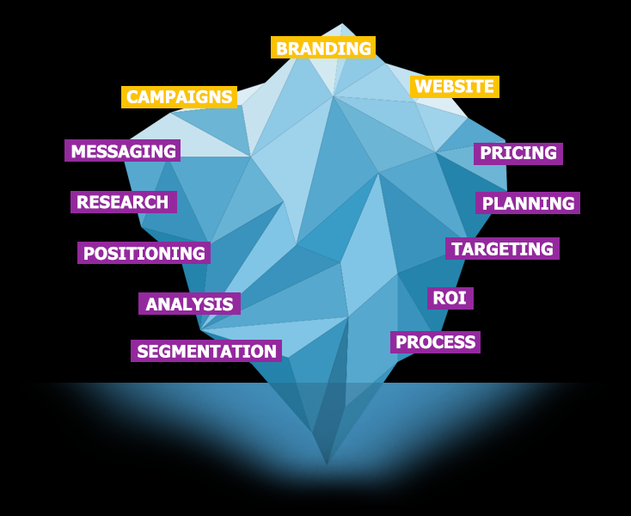
Iceberg theory in Marketing
Water level

Slide 5
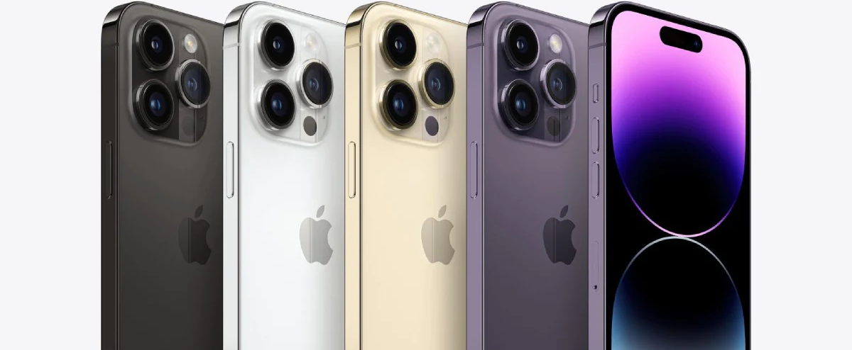
Do you need a salesperson to sell this?

Slide 6
Definitions of Marketing
Definition 01:
“Marketing is the management process responsible for Identifying, Anticipating and Satisfying customers’ requirements at a profit.”
( Charted Institute of Marketing- CIM UK)
Definition 02 :
“Marketing is the activity, set of institutions, and processes for creating, communicating, delivering, and exchanging offerings that have value for customers, clients, partners, and society at large.”
(American Marketing Association-AMA)

Slide 7
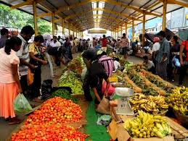
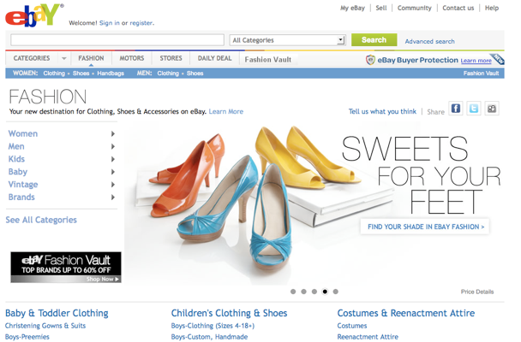
What is a Market?
Place
or
Space
Buyer and Seller meet for economic transaction

Slide 8
Scope of Marketing: What is Marketed? Products
“Any thing that can be offered to a market for attention, acquisition, use or consumption and that might satisfy a need or want”
goods
services
experiences
events
persons
places
properties
organizations
information
ideas

Slide 9

Marketing makes promises
“In the factory, we make cosmetics, in the store we sell hope”
Charles Revson of Revlon

Slide 10
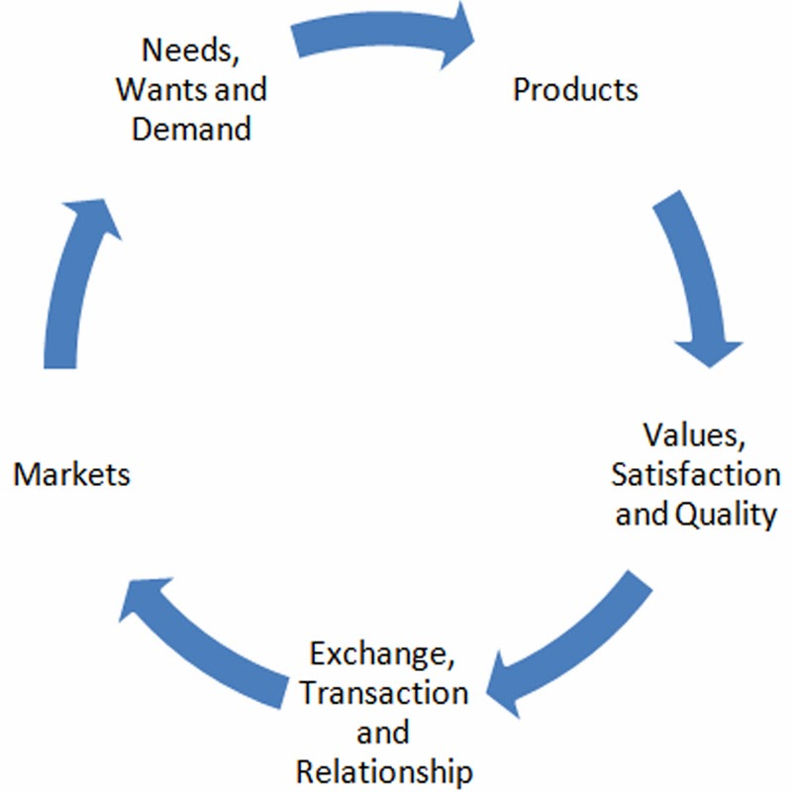
Core Marketing Concepts
Kotler & Armstrong 2004

Slide 11
Demand
Want
Need
A human need is a state of felt deprivation of some basic satisfaction. People require foods, clothing, shelter, safety, belonging, esteem etc. these needs exist in the very nature of human beings.
Human wants are desires for specific satisfiers of these needs. For example, cloth is a needs but Levis may be want. While people’s needs are few, their wants are many.
Demands are wants for specific products that are backed up by an ability and willingness to buy them. Wants become demands when backed up by purchasing power.

Slide 12





What is Marketing?

Slide 13
Marketing Mix
Product
Service
Product
Price
Place
Promotion
Product
Price
Place
Promotion
People
Process
Physical Evidence

Slide 14
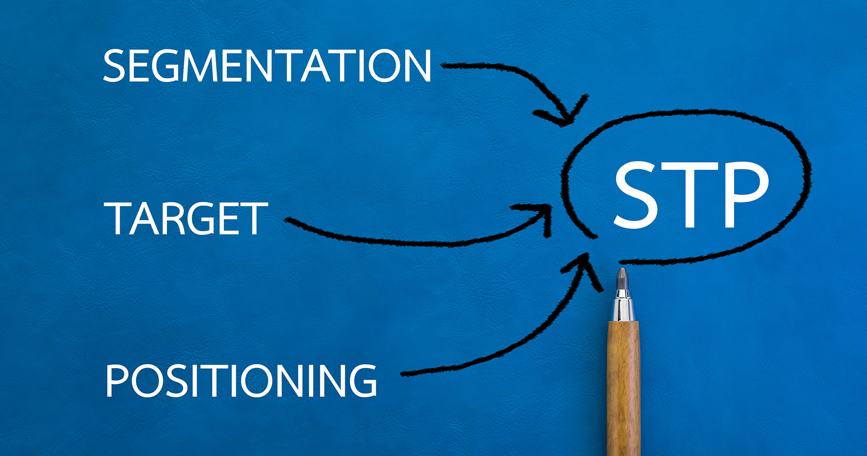
Core Marketing Concepts ….Cont….
Segmentation &Target market: which segments present the greatest opportunity.

Slide 15
Mass Marketing vs Target Marketing

Slide 16
Mass Marketing
Target
Marketing
Mass
Customization
Segmented Market(Clustered preferences)
Defuse Market
Heterogeneous- no similarities
Homogeneous Market
Similarities

Slide 17
Mass Marketing (Undifferentiated Marketing)
The seller engages in mass production, mass distribution, & mass promotion of one product for all buyers
E.g. Henry Ford applied the concept in the automobile industry. His Model T was conceived and marketed as a "universal" car—one that would meet the needs of all buyers .
Coca-Cola
Motives for Mass Marketing
(1) reduced costs through economies of scale made possible by the increased volume
(2) expanded volume through lower prices

Slide 18
Target Marketing/Micromarketing (Differentiated Marketing)
Is a market segmentation and market coverage strategy whereby a product is developed and marketed for a very well-defined, specific segment of the consumer population.
Target marketing is particularly effective for companies with limited resources because it enables the company to achieve a strong market position in the specific market segment it serves without mass production, mass distribution, or mass advertising. It enables firms to capitalize on the respective serve market share

Slide 19
Steps in Market Segmentation, Targeting, and Positioning
Market
Segmentation
Market
Targeting
Market
Positioning
1. Identify
segmentation
variables and
segment the
market
2. Develop
profiles of
resulting
segments
3. Evaluate
attractiveness
of each
segment
4. Select the
target
segment(s)
5. Identify
possible
positioning
concepts for
each target
segment
6. Select,
develop, and
communicate
the chosen
positioning
concept

Slide 20
Levels of Market Segmentation
Segment Marketing
Niche Marketing
Local
Marketing
Individual
Marketing

Slide 21
Segment Marketing
Market segment: Consists of a group of customers who share a similar set of needs and wants.
Benefits
Focus marketing programs for customers
Face fewer competitors in the particular segment

Slide 22
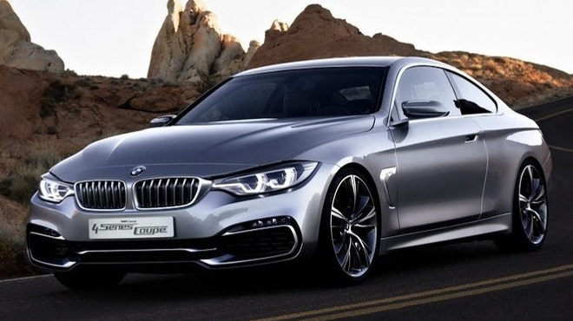
Niche Marketing
Niche: A more narrowly defined customer group seeking a distinctive mix of benefits
Niches are identified by dividing a segment into sub segments
Characteristics of Niche
Customers have a distinct set of needs
Customers ready to pay premium prices
Attract competitors due to profit & growth potential
Nicher gains economies through specialization
Notes:
Niche e.g.
E.g. Anchor Anlene, Signal Herbal

Slide 23


Niche Marketing: Example

Slide 24
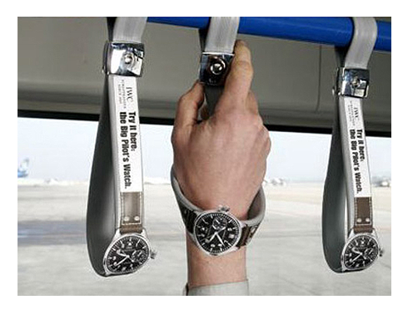
Local Marketing
Target marketing is leading to marketing programs tailored to the needs and wants of local customer groups in trading areas, neighborhoods, & individual stores
Guerilla marketing /Grassroots marketing: Marketing activities concentrate on getting as close & personally relevant to individual customers as possible.
Instead of launching a message you hope will appeal to many people, you target your efforts to a small group and hope the group will spread your message to a much larger audience.
low-cost
Unconventional means

Slide 25

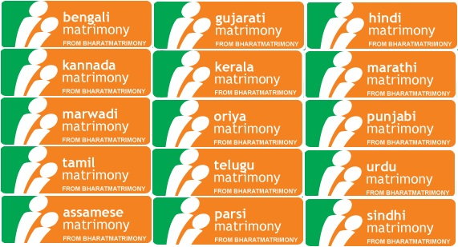
Local Marketing: E.g.

Slide 26
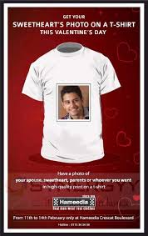
Individual Marketing
Segments of one/ Customized marketing/ One-to-one marketing
Empowers the consumers to design the product & service offering of their choice
Customization is not for every company
E.g : Hameedia – Customized T shirt

Slide 27
Bases for Segmenting
Geographic
Demographic
Psychographic
Behavioral

Slide 28

Geographic Segmentation
Division of the market into different geographical units such as nations, states, countries, cities, or neighborhoods.
Region: Districts, provinces, or prefectures
Rural or urban markets
Climate conditions
E.g. : Kadurata Sanwardana Bank, Wayaba Sanwardana Bank
Notes:
Hindustan unilever: Lifebuoy in rural India sell at low prices

Slide 29
Demographic Segmentation
Divide the market into groups on the basis of variables such as
Age
Family size
Family life cycle
Gender
Income
Occupation
Education
Religion
Race
Social class
Demographic variables are associated with consumer needs & wants
Demographic variables are used in combination with non-demographic variables

Slide 30
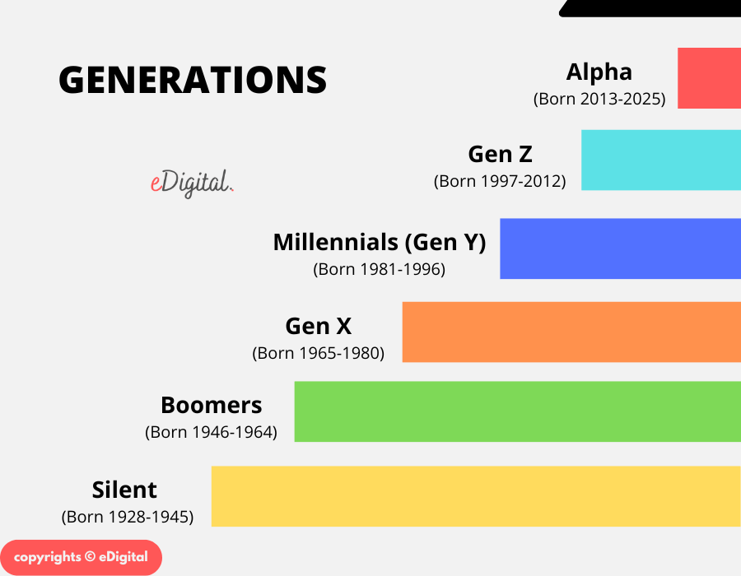
Characteristics about the consumer: Age :

Slide 31


Demographic Segmentation: Examples

Slide 32
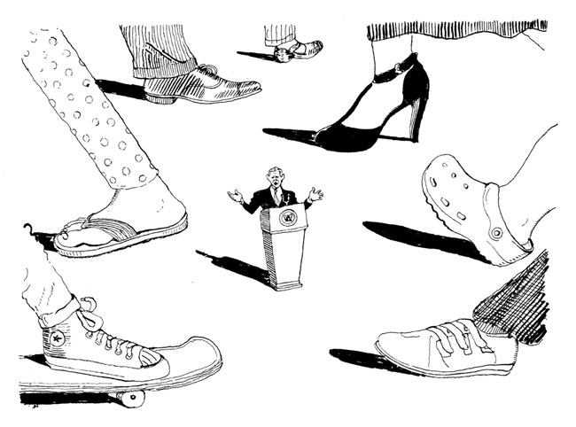
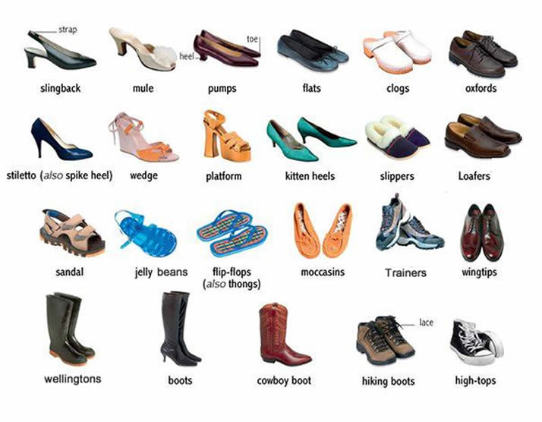
Psychographic Segmentation
Buyers are divided into groups based on psychological/personality traits, lifestyle, or values.
Lifestyle: Culture-oriented, sports-oriented, outdoor-oriented
Personality: Compulsive, gregarious, authoritarian, ambitious

Slide 33
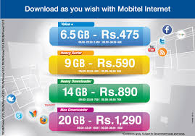
Behavioral Segmentation
Marketers divide buyers into groups based on their knowledge of, attitude toward, use of, or response to a product
Occasions: Regular, special
Benefits: Quality, service, economy, speed
User status: Nonuser, ex-user, potential user, first-time user, regular user
Usage rate: Light, medium, heavy
Loyalty status: None, medium, heavy
Readiness stage:
Unaware, aware, informed, interested, desirous, intending to buy
Attitude toward product
Enthusiastic, positive, indifferent, negative, hostile

Slide 34
Five Patterns of Target Market Selection
Selective
specialization
Product
specialization
Single-segment
concentration
M1 M2 M3
M1 M2 M3
M1 M2 M3
P1
P2
P3
P1
P2
P3
P1
P2
P3
Market
specialization
Full market
coverage
M1 M2 M3
M1 M2 M3
P = Product
M = Market
P1
P2
P33
P1
P2
P3

Slide 35
Positioning
positioning in marketing is a strategic process that involves creating an identity/ image of the brand or product within the target customers’ minds.

Slide 36
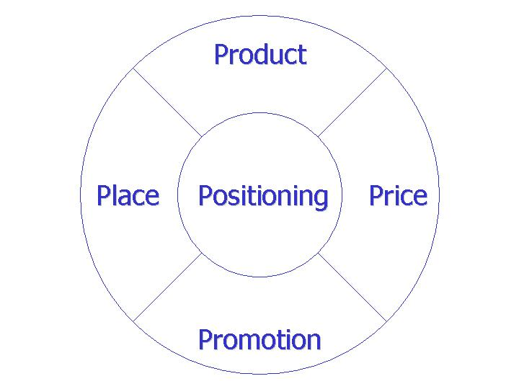

Positioning

Slide 37
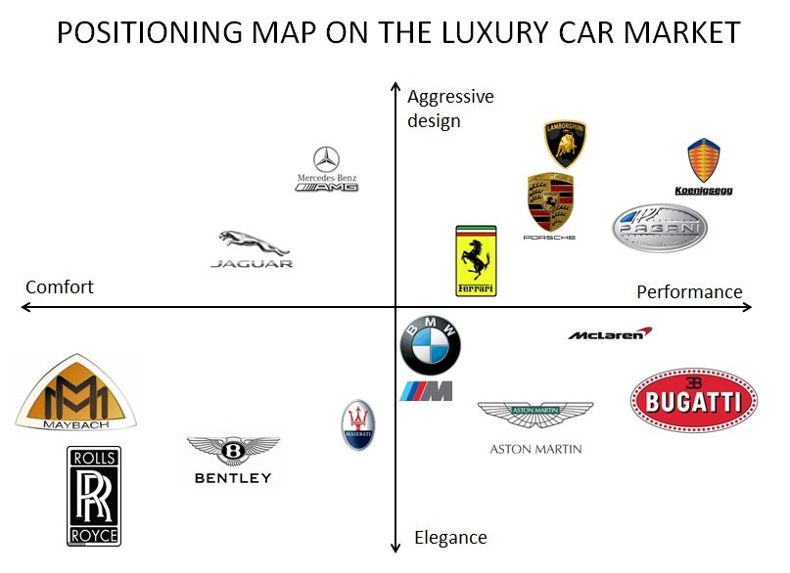

Slide 38
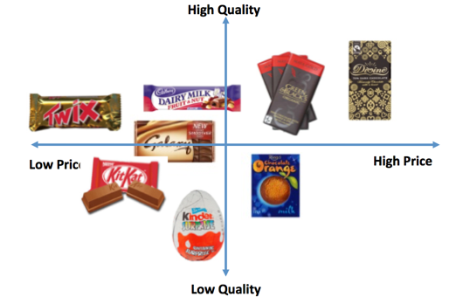

Slide 39
Marketing Mix
Good
Product
Price
Place
Promotion
Service
Product
Price
Place
Promotion
People
Process
Physical Evidence

